Slide 1

EVENT MANAGEMENT PLATFORM FOR ORGANIZING EVENTS

Slide 2

Introduction
Event management refers to the process of planning, organizing, coordinating, and executing events of various types and sizes, ranging from small gatherings to large-scale conferences, festivals, weddings, corporate meetings, and more. It involves overseeing all aspects of an event, from conceptualization and budgeting to logistics, marketing, and post-event evaluation.
Event Planning and Management: Allow organizers to create events with details such as date, time, location, description, and type of event
paymentProcessing: Integrate secure payment gateways to facilitate online payments for ticket purchases and event registrations.
Event Promotion: Provide tools for organizers to promote events through email campaigns, social media sharing, and integration with marketing platforms.
Continuous Improvement: Collect feedback from users and monitor platform.
Event Planning and Management: Allow organizers to create events with details such as date, time, location, description, and type of event
Payment Processing: Integrate secure payment gateways to facilitate online payments for ticket purchases and event registrations.
Event Promotion: Provide tools for organizers to promote events through email campaigns, social media sharing, and integration with marketing platforms.
Continuous Improvement: Collect feedback from users and monitor platform.

Slide 3

Abstract
Ensure the platform features an intuitive and easy-to-navigate interface that allows users to quickly access and utilize its functionalities without requiring extensive training .
Optimize the platform for mobile devices to enable users to access event information, register, and engage with content on-the-go, enhancing convenience and accessibility.
Ensure the platform delivers real-time updates and live event feeds to keep attendees engaged and informed about event activities, schedules, and announcements as they happen.

Slide 4
objectives
Streamline Event Planning:-This includes managing event details, scheduling, budgeting, and task assignment.
Facilitate Efficient Communication: Providing tools for seamless communication and collaboration can enhance coordination and ensure everyone involved is on the same time.
Support Scalability and Flexibility: Objectives may include designing modular and customizable features that can adapt to evolving business needs and user preferences.
Customer Satisfaction and Loyalty: the objective of the Event Management Platform should be to drive customer satisfaction and loyalty among organizers, attendees, sponsors, and other stakeholders

Slide 5


Material and methods
Utilize UML diagrams such as use case diagrams, class diagrams, sequence diagrams, and state diagrams to model the various aspects of the event management platform, including user interactions, system component and
Work flow process
Implement the event management platform using object-oriented programming languages like Java, C++, or Python, which allow for the creation of reusable and modular components represented as object

Slide 6
Results
The system should enhance the overall attendee experience by providing easy registration, personalized communication, and access to event details, schedules, and updates in real-time.
Organizers should benefit from improved productivity and collaboration tools that enable better coordination, communication
decision-making throughout the event planning and execution process.
By capturing and analyzing attendee data, feedback, and engagement metrics the system should provide organizers
valuable insights to measure event success, identify trends, and make data-driven decisions for future events.

Slide 7
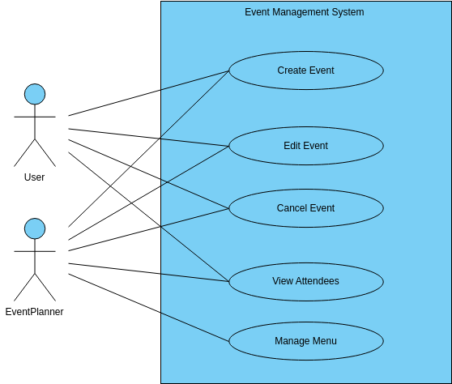
USE CASE DIAGRAM

Slide 8
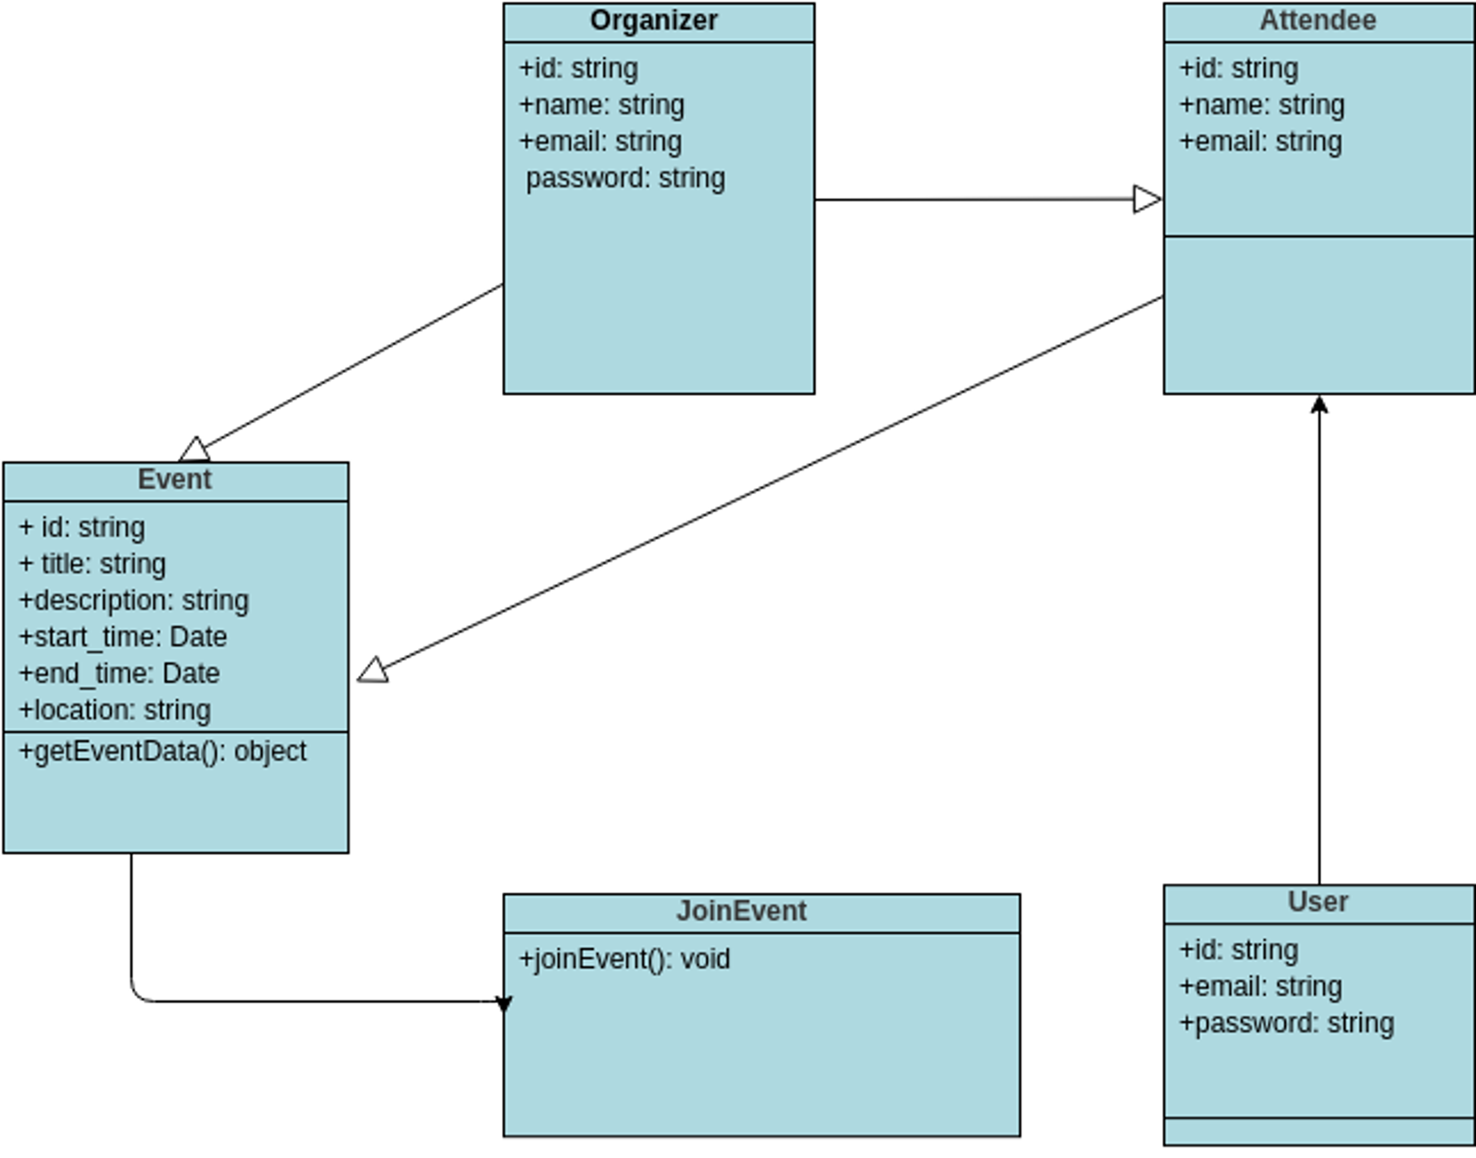
CLASS DIAGRAM

Slide 9
conclusion
. The conclusion can highlight how an effective event management system streamlines processes, reduces manual errors, and enhances overall efficiency in planning and executing events.
By utilizing such a system, event organizers can save time, resources, and effort, allowing them to focus more on creativity and delivering exceptional experiences for attendees
As new innovations emerge and existing systems evolve, organizers can look forward to even greater efficiency, effectiveness.
creativity in planning and executing memorable events that leave a lasting impact on attendees.

Slide 10


